Slide 1
The embodiment of disadvantage: Developmental programming and the lifecourse
Dr Natasha Kriznik, St John’s College Cambridge
Prof Mike Kelly, St John’s College Cambridge
Prof Ann Louise Kinmonth, St John’s College Cambridge
Prof Graham Burton, St John’s College Cambridge
BSA Medical Sociology Conference Wednesday 7th-Friday 9th September 2016
Aston University

Slide 2
Overview
Developmental programming
Relevance for sociology
The research project
Intergenerational transmission of health inequalities: linking sociological and biological explanations
Policy implications
Conclusion

Slide 3
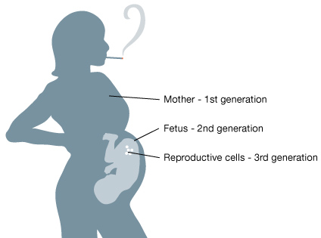
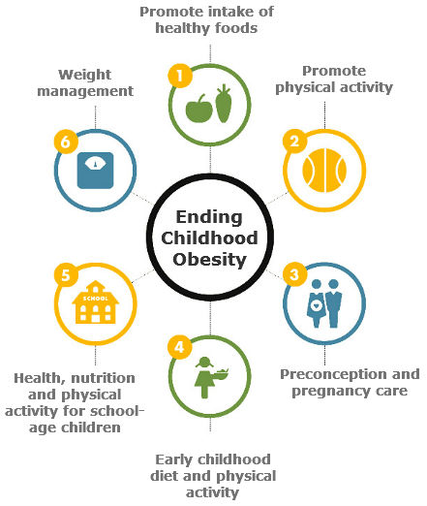
Developmental programming
Biological process where environmental factors influence gene expression during in utero growth and beyond
  Elevated stress hormones
  Poor maternal nutrition
Particularly important for periconceptional period:
14 weeks before conception to 10 weeks after
conception
How early life events, both in the womb and after birth, influence future (adult) health and well-being

Slide 4
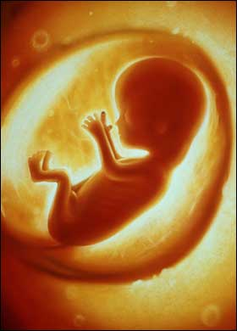

Why should (medical) sociology be interested?
Developmental programming concerned with influence of wider environment and its impact on biological development
The foetus's environment is the mother; the mother’s environment is the social
Norms and expectations
Everyday practices
Socio-economic situation
Food and drink
Pollution
Living conditions
Environment/biosphere
Working conditions

Slide 5
Why should (medical) sociology be interested?
Sociology is aware of the impact of social context on health - but fewer clear attempts to substantially link with biological explanations
  Historical tensions
  Fears of reductionism
Some moves towards suggesting the need for further integration (e.g. Meloni) but not really mainstream thinking
Yet pregnancy, early years and childhood development are key areas in public health policy and research – as well as health

Slide 6
Why should (medical) sociology be interested?
“No longer are social theories thought progressive by virtue of their distance from the biological” (Rose, 2013: 4)
The sociobiological translation: “how human beings receive messages regarding their social conditions, convert the information into perceptions, and then translate the perceptions into biological signals that are antecedents to diseases which may take decades before becoming clinically apparent” (Tarlov, 1996: 71)
Epigenetics “provides a new understanding of the ways in which social and biological experiences and processes intertwine across the life course and may even be inherited across generations” (Warin et al., 2015: 5)

Slide 7
The research project
Interdisciplinary group: sociologists,
philosophers, medics, biologists, psychologists,
historians
Interested in the interface between
the social and biological systems
in relation to health
Exploring sociological theory and concepts
that might illuminate this interface
Disease causation
Health Inequalities
Developmental programming
Social
Biological
HEALTH

Slide 8

Social capital and health
Transmission of social (dis)advantage
  Networks as a resource
  Relationships with others –
  “it’s not what you know but who you know”
  Group identity, cohesion
  Collectively owned capital
  Norms, values, practices within the network → habitus
Cultural expectations and meanings
Requisite knowledge
Materials and resources
Adapted from Shove et al (2012)

Slide 9
Social and biological (dis)advantage
Social capital is about transmission of social advantage
We are interested in sociological understanding of the social transmission and social reproduction of biological disadvantage (and advantage)
The clues originally come from David Barker’s foetal origins hypothesis and studies of the effects of the Dutch Famine (Kelly, Kelly, Russo 2014)

Slide 10
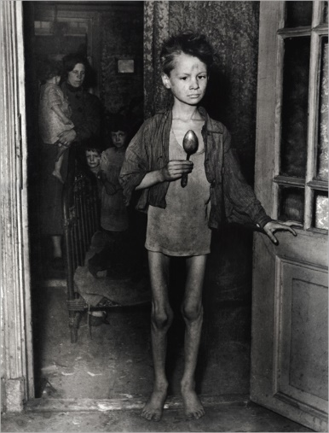
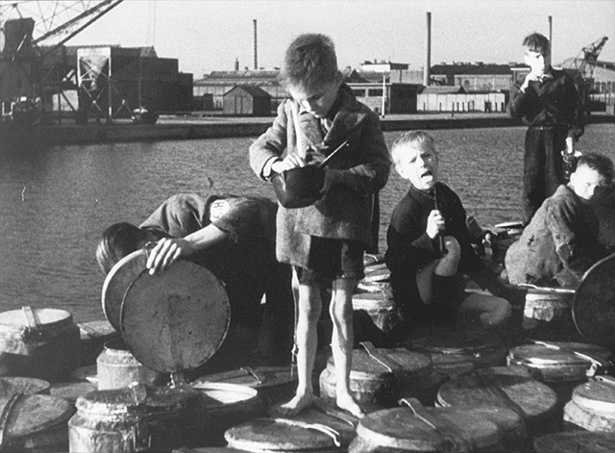
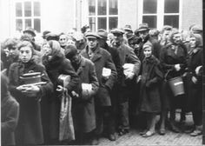
Dutch Hunger Winter and epigenetics
9 months of enforced famine in 1944-1945
Provided scientists with a unique study population:
  Stage of pregnancy during famine affected birth weight
  Those malnourished in latter stages stayed small, while those malnourished in early stages more prone to health problems (e.g. obesity)
  Effects present in grandchildren

Slide 11
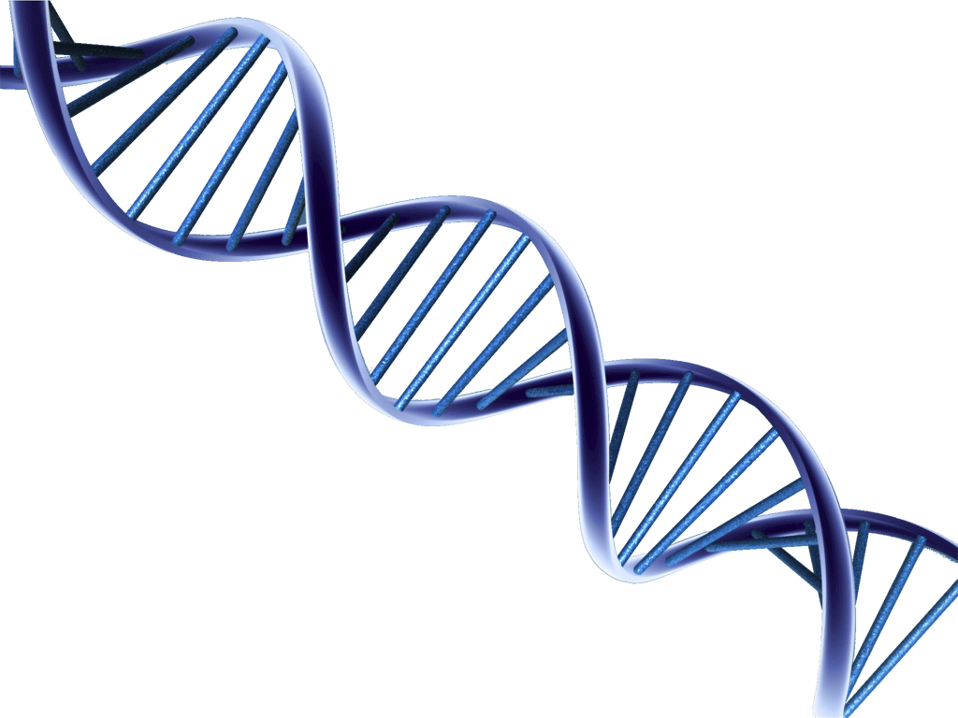
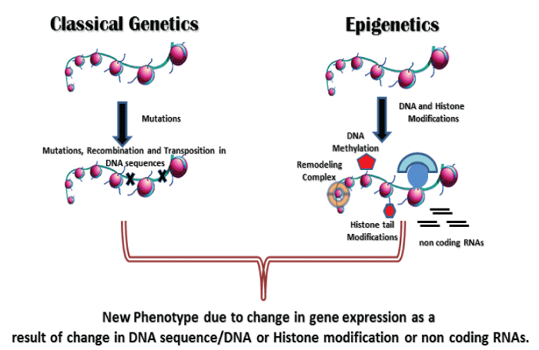
Dutch Hunger Winter and epigenetics
Epigenetic mechanisms (“above the genome”)
  Epigenetic markers affect gene expression, especially in early development
  Not fixed: susceptible to environmental influences
  Intergenerational transmission of markers

Slide 12
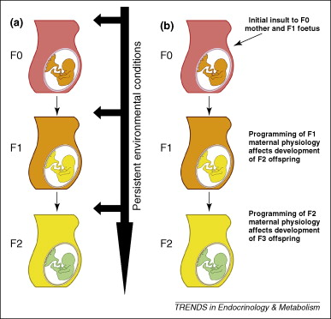
‘Biological capital’ and health
Transmission of biological/health (dis)advantage
  Biology/health as a resource given at birth
  Intergenerational transmission (Drake and Liu, 2010)
    Constant environmental exposure (a)
    Epigenetic effects (b)
  Dynamic across the lifecourse: can increase or
  decrease due to environment and behaviours –
  but always based on initial “stock”
  Individually owned capital

Slide 13
Problems to avoid
These findings from biology could be used to justify the re-emergence of eugenic ideas
  Need to avoid classist discussions
  Engagement between social scientists and life scientists
Blaming women/mothers
  Easy to see further pressure being placed on women before/during/after pregnancy → behaviour
  Recognise importance of social practices
  influencing actions, linked to social capital
Cultural expectations and meanings
Requisite knowledge
Materials and resources

Slide 14



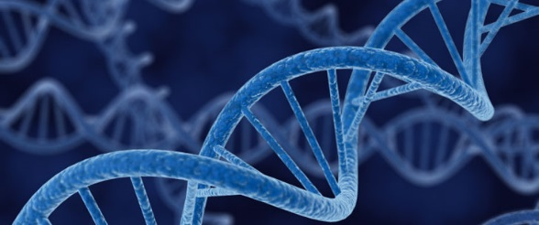
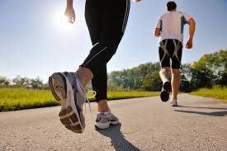
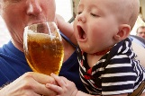


Policy implications
“Understanding the mechanisms by which programming effects are induced and transmitted across generations has important implications for designing interventions to improve human health.” (Drake and Liu, 2010: 210)
Rethinking assumptions about differences and equality
  Challenge ideas that some things are unequal by virtue of biology: inheritance of biological responses to social conditions

Slide 15

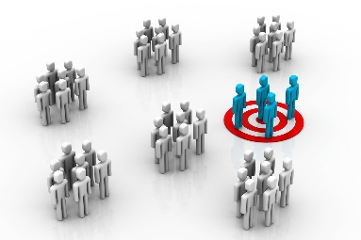
Policy implications
Need to consider historical influences:
  1000 days and 100 years
  Recognise impact of the past; address
  current problems; plan for the future
Moving away from emphasis on individual behaviours, and instead addressing wider social practices and conditions
  Avoid blaming women/mothers
  “An important task for the emerging field of social epidemiology is to identify the collective characteristics of communities and societies that determine population health status” (Kawachi and Berkman, 2000: 174).

Slide 16
Conclusion
Developmental programming and epigenetics are important areas for work on health and health inequalities – greater sociological engagement needed
“Biological capital” as a way of theorising our own biological resources and their transmission
Tied in to other forms of capital, particularly social capital, and also social practices and wider societal/environmental conditions
Moving towards an integrated social-biological explanation for health inequalities

Slide 17

Thank you for listening!
Acknowledgements
St John’s College Annual Fund
Prof. Ann Louise Kinmonth
Prof. Mike Kelly
Reading Group website: http://www.joh.cam.ac.uk/st-john%E2%80%99s-reading-group-health-inequalities
Contact
nmk33@medschl.cam.ac.uk
@NMKriznik

