Slide 1
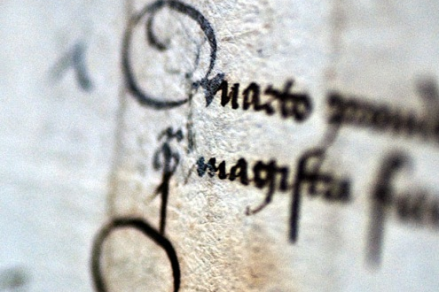
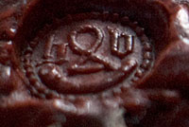
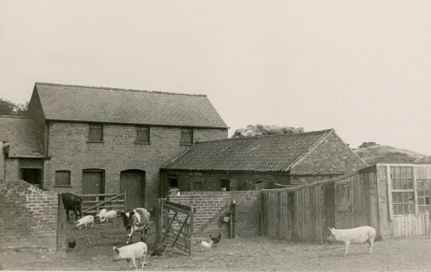
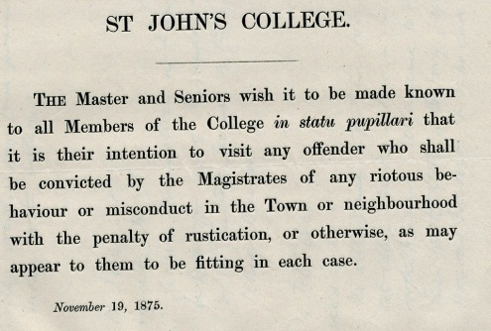
Using archives for dissertations
Tracy Deakin
Archivist
St John’s College

Slide 2
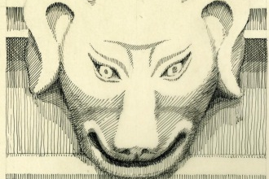
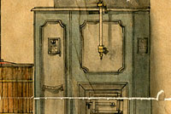
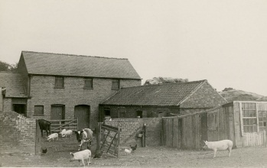
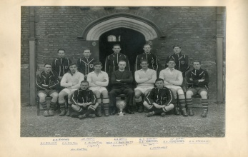
It depends on those who pass
Whether I am a tomb or treasure
Whether I speak or am silent
The choice is yours alone.
Friend, do not enter without desire.

Slide 3
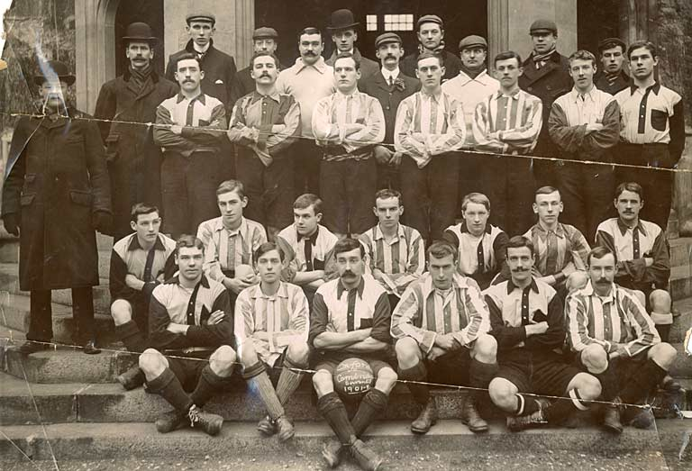
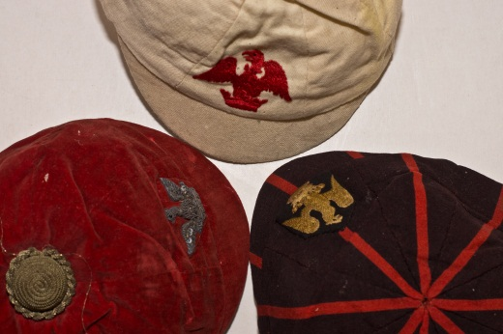
What are archives?
Archives are the stuff of history, bringing past events to life and so allowing us to explore the past. They can be beguiling and frustrating in equal measure.

Slide 4
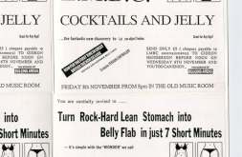
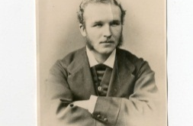
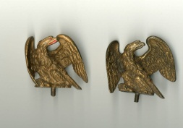
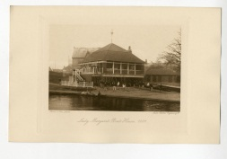
What can I expect to find?
Manuscript & printed material
Maps, plans & architectural drawings
Engravings & photographs
Cartoons, film, sound recordings
Digital material & objects

Slide 5
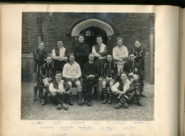
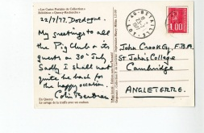
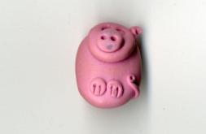
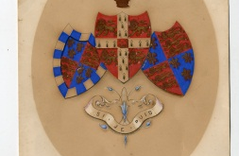
Where should I start?
Start with secondary sources - look at bibliographies & footnotes. What sources have others used?
Explore online resources
Make sure you find out whether there are any transcripts, calendars (short summaries) or translations of the documents you want to use.

Slide 6
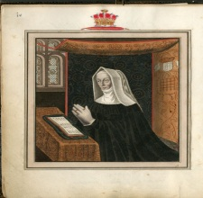
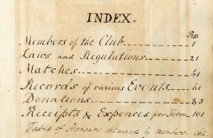
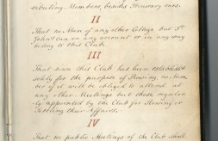
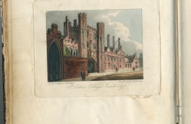
Searching catalogues
Before you start remember that…
Each archive has its own catalogue
Not all catalogues are complete
Not all catalogues are available online
Very few records are available online
Archives have many useful finding aids to help you find material but many of these are only available in the searchroom.

Slide 7
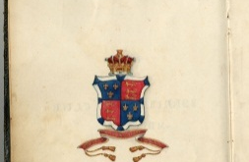
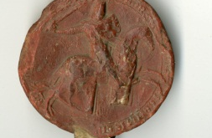
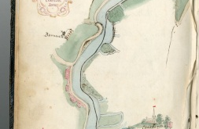
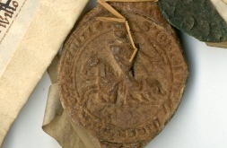
Search terms
Archive catalogues are not like library catalogues. Archives don’t fall into neat categories which means that extra care needs to be taken when choosing search terms.
Try to think outside the box - think about what terms might be used in the records themselves

Slide 8
Tips for visiting & using an archive
Make contact with an archive before you visit. Check opening times, closure periods and what ID you need to bring.
If the archive’s catalogue is available online check this before you make contact – so you know what you’re looking for.
Can you take a camera to take digital copies (sometimes there can be a charge for this)?
Take a pencil with you – no pens in archives.

Slide 9
Tips for visiting & using an archive
Wear or take something warm – searchrooms are often chilly.
Don’t bring food or drink with you.
Be organised and systematic – go through your references.
Take full notes –particularly of the full reference (down to folio, page or quire number).
Always ask for help if you need it.

Slide 10
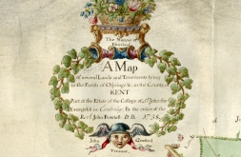
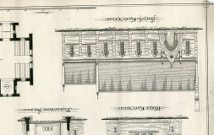
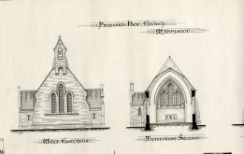
How to find the right archive
Cambridge: http://janus.lib.cam.ac.uk
London: www.aim25.ac.uk
Oxford: www.oxfordarchives.org.uk
National Collections:
The National Archive (TNA) www.nationalarchives.gov.uk
The National Library of Wales (NLW) www.llgc.org.uk
The National Archives of Scotland (NAS) www.nas.gov.uk

Slide 11
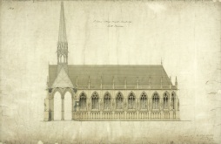
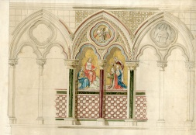
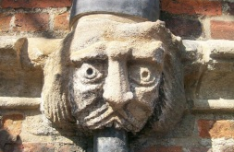
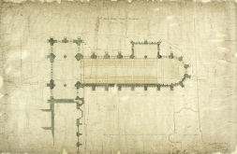
Online Resources
Using archives – a guide for the inexperienced http://archiveshub.ac.uk/guides/usingarchives/
Beginner’s Latin www.nationalarchives.gov.uk/latin/beginners
Latin palaeography http://www.nationalarchives.gov.uk/latin
English handwriting www.english.cam.ac.uk/ceres.ehoc/

Slide 12
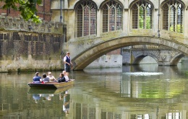
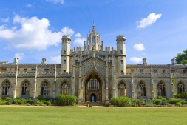
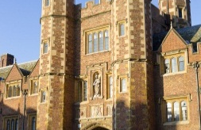
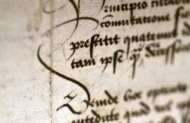
Tracy Deakin
Archivist, St John’s College
archivist@joh.cam.ac.uk
http://www.joh.cam.ac.uk/archives

