Slide 1
A sociological and historical perspective on health inequalities: implications for current policy debates.
Mike Kelly & Simon Szreter
University of Cambridge

Slide 2
Thanks to the St John’s College Reading Group on Health Inequalities and the St John’s College Annual Fund.

Slide 3
Three key ideas.
Individual and population level explanations of inequalities are muddled in policy discourse.

Slide 4
Three key ideas.
Individual and population level explanations of inequalities are muddled in policy discourse.
Gross categories like SES conceal more than they reveal.

Slide 5
Three key ideas.
Individual and population level explanations of inequalities are muddled in policy discourse.
Gross categories like SES conceal more than they reveal.
Granularity of explanations of patterning of health inequalities still to be systematically developed.

Slide 6
The accumulated evidence
Longstanding observations concerning health inequalities
Antonovsky 1967
Black, Whitehead, Acheson, Marmot….

Slide 7
The health gradient
Hi
Health state
Lo
Lo
Hi
Social status

Slide 8
The aggregation assumption.

Slide 9
The aggregation assumption.
The summation of individual cases produces population health.

Slide 10
The aggregation assumption.
The summation of individual cases produces population health.
But…

Slide 11
The aggregation assumption.
The summation of individual cases produces population health.
But
  Explanations of individual disease cases do not explain the patterning.

Slide 12
The aggregation assumption.
The summation of individual cases produces population health.
But
  Explanations of individual disease cases do not explain the patterning.
  Social level of analysis absent.

Slide 13
The difference between population health and individual health
Why is Mr Smith sick?

Slide 14
The difference between population health and individual health
Why is Mr Smith sick?
Why is the health of the population of the West of Scotland worse than everywhere else in the UK?

Slide 15
Moving beyond coarse categories.

Slide 16
The health gradient
Hi
Health state
Lo
Lo
Hi
Social status

Slide 17
Theoretical and empirical dimensions of the contours and dimensions of inequality not well described – the axes of differentiation and their intersection completely missing from the evidence base.

Slide 18
Kelly, M.P. (2010) The axes of social differentiation and the evidence base on health equity. Journal of the Royal Society of Medicine, 103: 266-72,
DOI .1258/jrsm.2010.100005

Slide 19
Intersections between…

Slide 20
Intersections between…
Social class.
Occupation.
Gender.
Ethnicity.
Status.
Disability.
Sexual orientation.
Education
Income

Slide 21
Single variables too coarse to capture social variegation in the population or to guide interventions.

Slide 22
Single variables too coarse to capture social variegation in the population or to guide interventions.
Must think in relational and dynamic terms and avoid reductionism and relying on cross sectional data.

Slide 23
The patterning of national health inequalities may be understood as emergent properties of dynamic local socio-historical contexts.

Slide 24
Local granularity.

Slide 25
Case example.

Slide 26
Asbestos related disease in East London

Slide 27
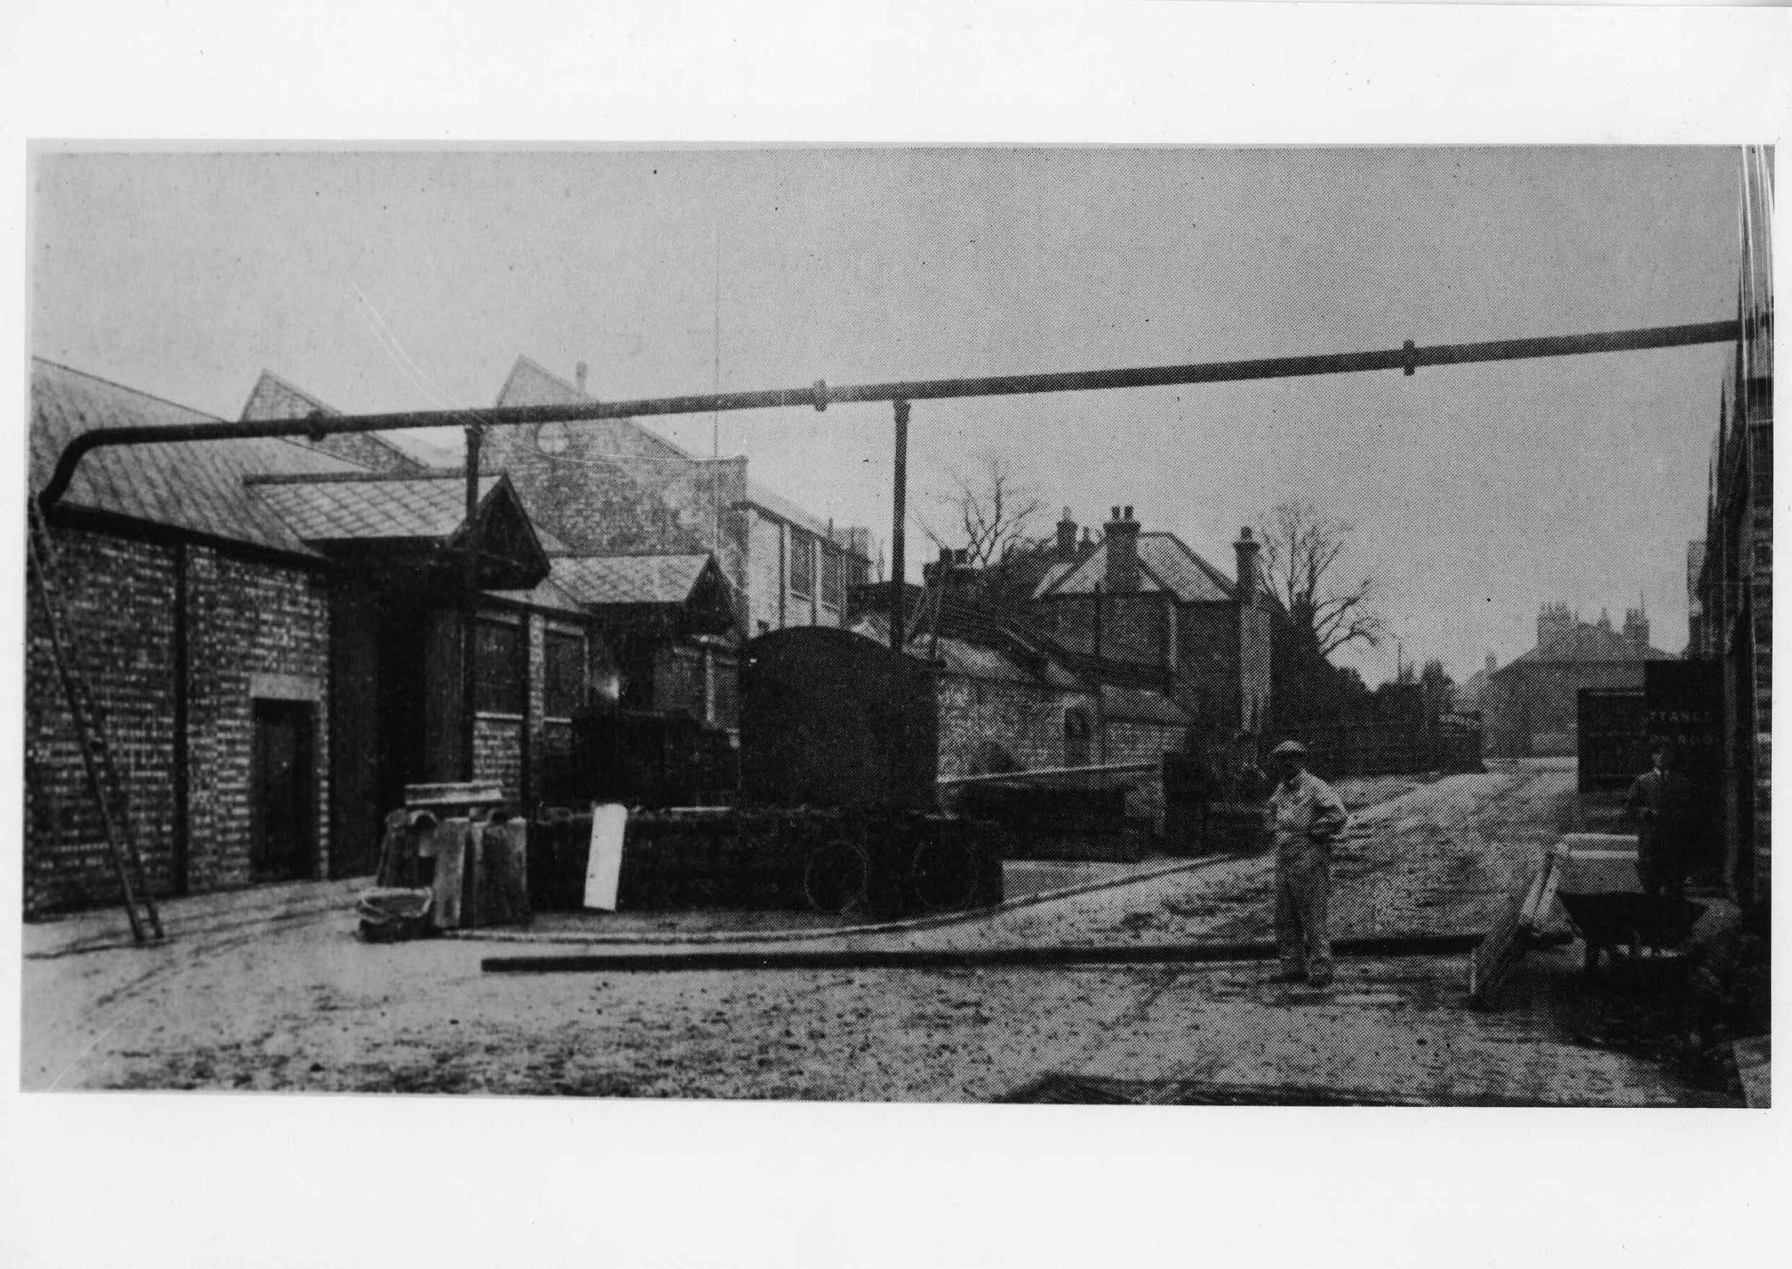

Slide 28
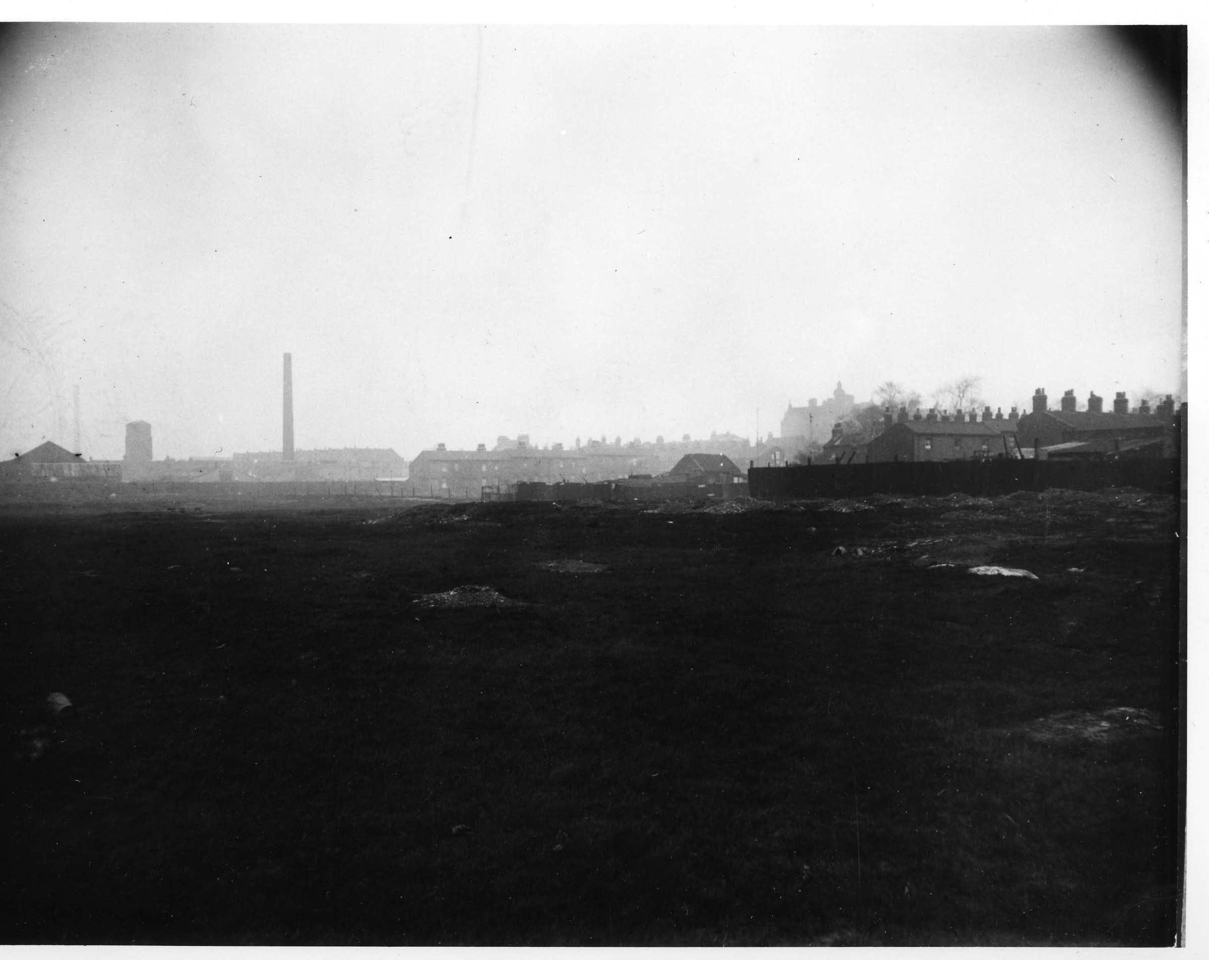

Slide 29
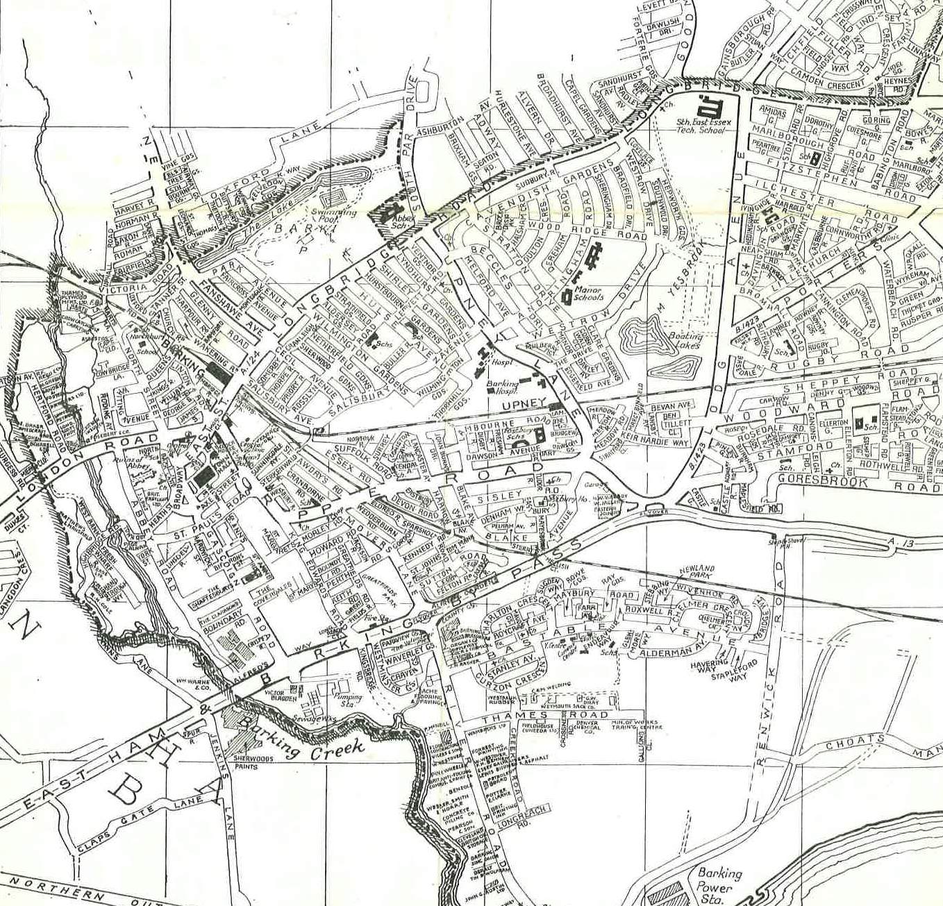

Slide 31
Overlapping lifeworlds

Slide 32
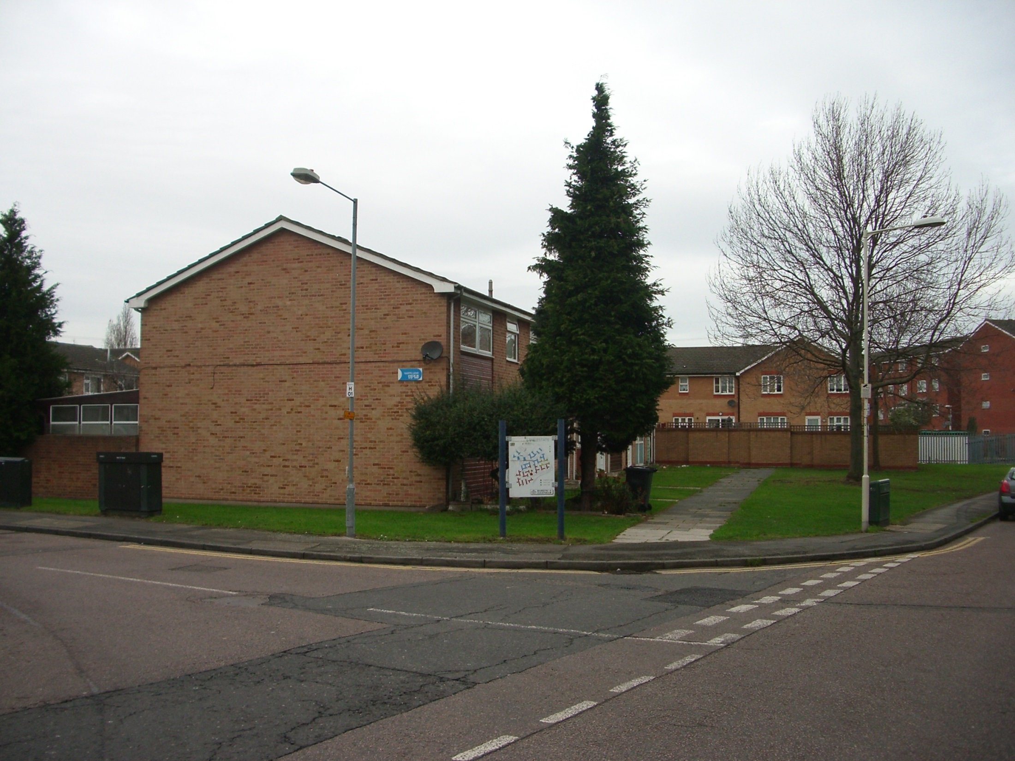

Slide 33
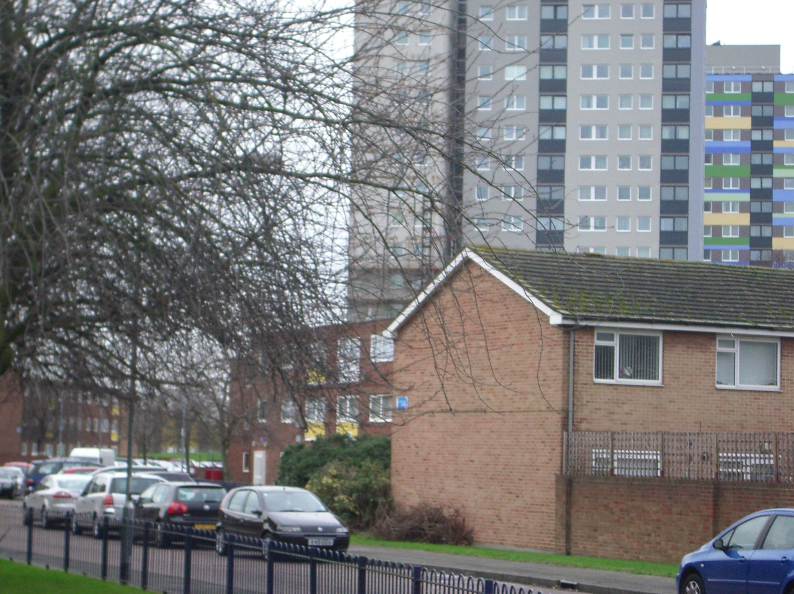

Slide 34
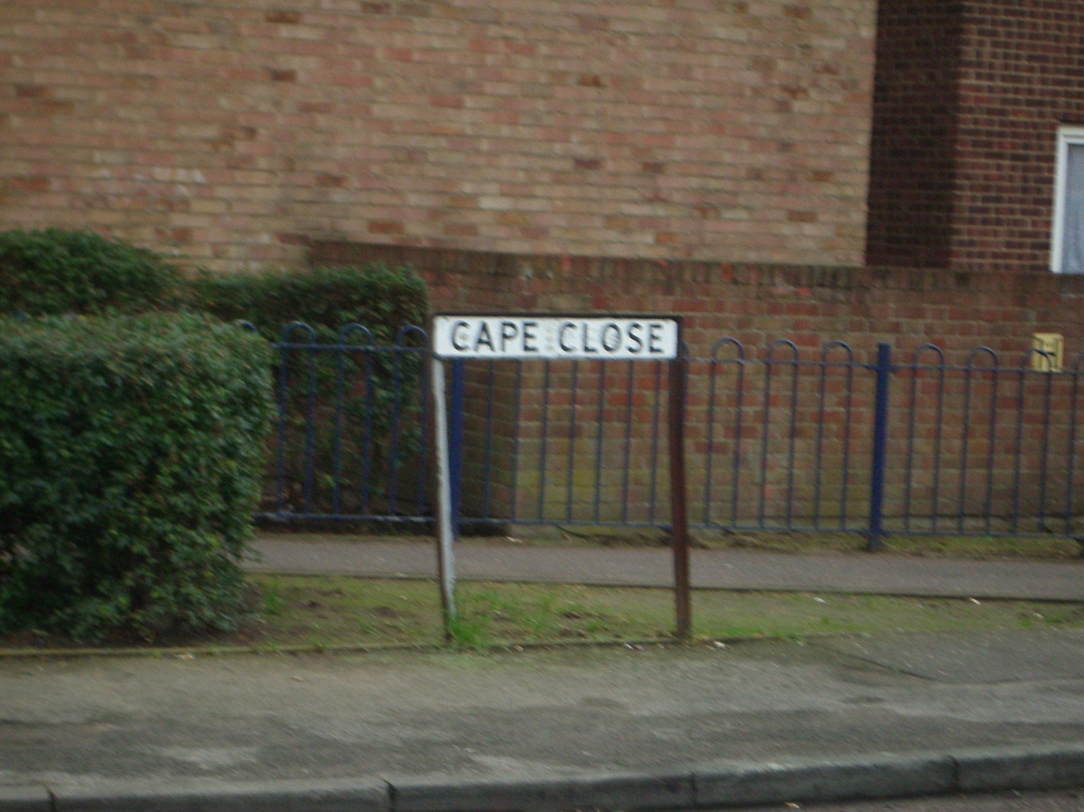

Slide 35
Dimensions of local generation of patterning of inequalities.

Slide 36
Work relations – workshops, factories, mines, farms.

Slide 37
Work relations – workshops, factories, mines, farms.
Interaction between domestic and work life.

Slide 38
Work relations – workshops, factories, mines, farms.
Interaction between domestic and work life.
Industrialisation and deindustrialisation - West of Scotland, South Wales, South Yorkshire; mass privatisation in the former Soviet Union.

Slide 39
Plus.
Political and power relations in municipal politics.
Gender relations.
Ethnic relations.
Class relations.

Slide 40
Other case examples.
Dundee
Birmingham & Sheffield.
Glasgow
Leicester
Manchester/ Salford.

Slide 41
Current individualistic solutions.
Health checks.
Individual behaviour change.
Better diets, more physical activity.
Targeted approaches.

Slide 42
Whither a relational or social perspective?

