Slide 1
Integrated mechanisms describing the relationship between the social and the biological
The sociological contribution to developmental programming
Mini-Symposium on Developmental Programming of Human Disease: Preconception Nutrition and Lifelong Health
22nd-25th February 2016
Dr Natasha Kriznik, St John’s College Cambridge nmk33@cam.ac.uk
Post-Doctoral Research Associate for the St John’s College Reading Group on Health Inequalities

Slide 2
Outline
Developmental programming
The missing sociological contribution
Existing literature on social causes of disease
St John’s Reading Group on Health Inequalities
Key sociological concepts
Links to the lifecourse
Thinking about periconceptional diets using social practice theory
The sociological contribution to developmental programming

Slide 3
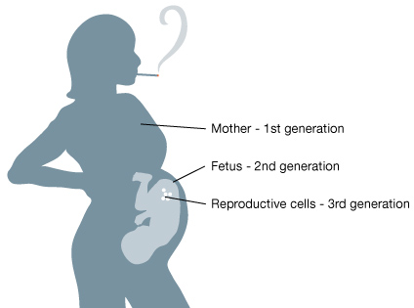
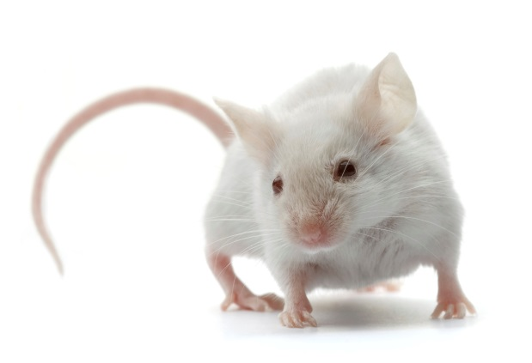
Developmental programming and epigenetics
Growing foetus is sensitive to alterations in the environment
Concern about biological mechanisms – how
physiological adaptations to changes in early
environment lead to permanent programming
of organ systems
How early life events, both in the womb and after birth, influence future (adult) health and well-being
Moving beyond mouse models…
  How do we think about this for humans?
  How can we influence periconceptional diets?

Slide 4
Where’s the sociological contribution?
DP and epigenetics concerned with influence of wider environment and its impact on biological development
Social context is therefore important – this seems to be recognised in DP and epigenetics through increases in maternal cortisol
Sociology is aware of the impact of social context on health - but fewer clear attempts to substantially link with biological explanations
  Historical tensions
  Fears of reductionism
Yet pregnancy, early years and childhood development are key areas in public health policy and research

Slide 5
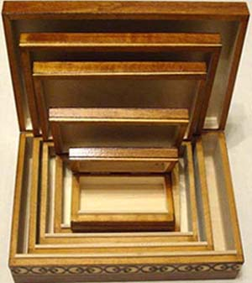
Existing literature on social causes of disease
Social
The social as a precondition for disease
  Susser and Susser (1990) – “Chinese boxes”
  Thisted (2003)
  Direct effect on health and disease
  Cockerham (2007) – social factors can initiate pathology
  Link and Phelan (1995) – social factors as a direct cause of illness
Biological
Kelly et al. (2014)

Slide 6

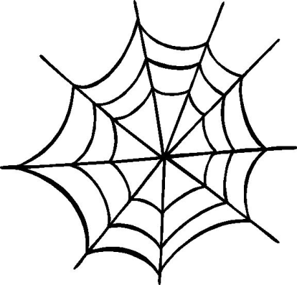

Existing literature on social causes of disease
Population factors
  Rose (2008) – “population strategy”
The “causes of causes”
    Marmot and Wilkinson (2005) – multiple influences across the lifecourse
A “web of causation”
  Krieger (1994) – ecosocial perspective
Kelly et al. (2014)

Slide 7
St John’s Reading Group on Health Inequalities
Interdisciplinary group: sociologists,
philosophers, medics, psychologists,
historians
Interested in the interface between
the social and biological systems
Identified sociological concepts that
could help negotiate this boundary
Disease causation
Health Inequalities
Developmental programming
Social
Biological
HEALTH

Slide 8
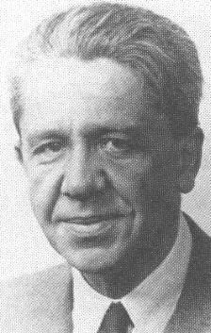
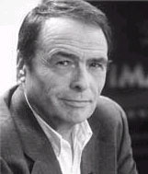
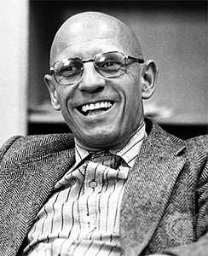
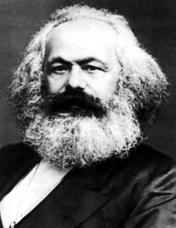
Key sociological concepts
The lifeworld –Schutz
  Sociology and phenomenology
Social practice theories
  Number of theorists: Bourdieu, Giddens, Foucault, Marx…

Slide 9
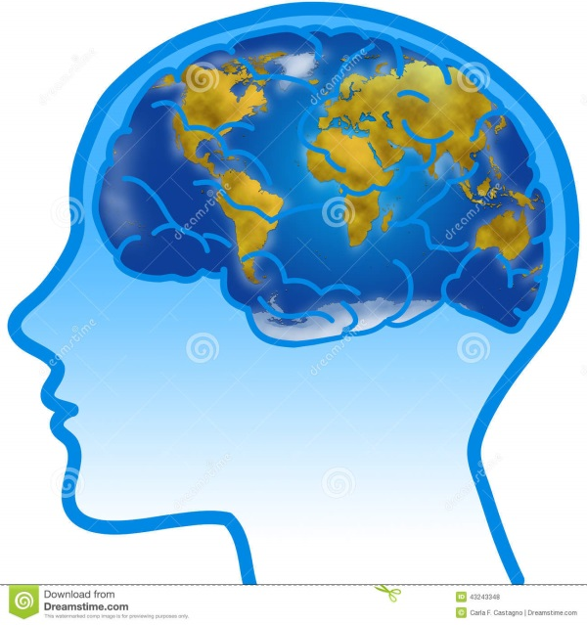
The lifeworld
What is the lifeworld?
How can this contribute to DP?
A way of conceptualising how individuals think about, or model, the world in order to make sense of it
Lived experiences provide us with a view of the world and gives a sense of place and self-worth
Also how individuals understand others’ views of the world – “intersubjectivity”
We all inhabit different lifeworlds and these are shaped by our interactions with others, and their lifeworlds
How the brain models the world in early life, how this shapes future decisions and choices

Slide 10

Social practice theory
What is social practice theory?
How can this contribute to DP?
Practices are made up of:
  Intersectionality of practices – how certain practices are linked (e.g. healthy breakfast, food shopping, preparing food)
Practices rather than choices are central – avoids individual behavioural focus and blaming individual
Practices shaped by surrounding environment (physical and social)
Recruitment
Cultural expectations and meanings
Adapted from Shove et al (2012)
Requisite knowledge
Materials and resources

Slide 11
Social practice theories
Lifecourse
Structuration
Lifeworld

Slide 12
Thinking about periconceptional diets (and health) using social practice theory
Diet and lifestyles of women of child-bearing age – also partners!
Awareness of lifecourse – experiences which shape lifeworld and expectations
Moving beyond individualist paradigm of lifestyle – “Agency allows them to reject or modify these patterns, but structure limits the options that are available” (Cockerham, 2005)
Not just about providing people with information/education and expecting them to make better choices
Need to consider practice-based responses
Cultural expectations and meanings
Requisite knowledge
Materials and resources

Slide 13
The sociological contribution: social practices
How people view the world, interact with it, the practices they undertake: these are recursive and become routine, habitual – and clearly have a biological impact
All social practices affect health in some way, either positively or negatively
  Not just about individual behaviour or choices – how actions (e.g. healthy breakfast) are influenced by
  wider cultural expectations and meanings,
  obtaining the resources to undertake certain actions,
  having the knowledge to participate in practices
  Integrated thinking – practices as a way for social theory to engage more directly with biological processes

Slide 14
Thank you for listening!
Thank you to The Rank Prize Funds for inviting me
Acknowledgements:
St John’s College Annual Fund
Prof. Mike Kelly
Prof. Ann Louise Kinmonth
Email: nmk33@cam.ac.uk
Twitter: @NMKriznik

