Slide 1
Integrated mechanisms describing the relationship between the social and the biological
The sociological contribution to developmental programming
BSA Human Reproduction Study Group Conference
10th June 2016
Dr. Natasha Kriznik, St John’s College Cambridge nmk33@cam.ac.uk
Post-Doctoral Research Associate for the St John’s College Reading Group on Health Inequalities
Prof. Mike Kelly, St John’s College Cambridge mk274@cam.ac.uk
Cambridge Institute of Public Health, Department of Public Health and Primary Care

Slide 2
Outline
Developmental programming
Missing sociological contribution
Existing literature on social causes of disease
Research project
Key sociological concepts
Links to the lifecourse
Thinking about periconceptional diets using social practice theory
The sociological contribution to developmental programming

Slide 3
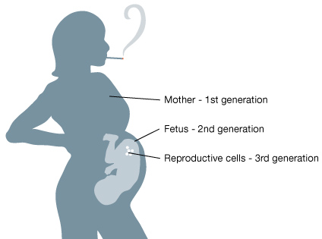
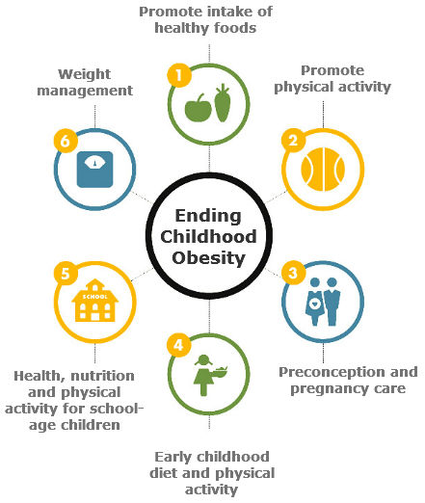
Developmental programming
Biological process where environmental factors influence gene expression during in utero growth and beyond
  Elevated stress hormones
  Poor maternal nutrition
Particularly important for periconceptional period:
14 weeks before conception to 10 weeks after
conception
How early life events, both in the womb and after birth, influence future (adult) health and well-being

Slide 4
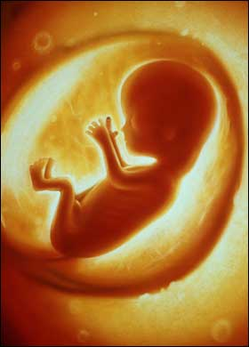

Where’s the sociological contribution?
Developmental programming concerned with influence of wider environment and its impact on biological development
The foetus's environment is the mother; the mother’s environment is the social
Norms and expectations
Everyday practices
Socio-economic situation
Food and drink
Pollution
Living conditions
Environment/biosphere
Working conditions

Slide 5
Where’s the sociological contribution?
Sociology is aware of the impact of social context on health - but fewer clear attempts to substantially link with biological explanations
  Historical tensions
  Fears of reductionism
Some moves towards suggesting the need for further integration (e.g. Meloni) but not really mainstream thinking
Yet pregnancy, early years and childhood development are key areas in public health policy and research

Slide 6
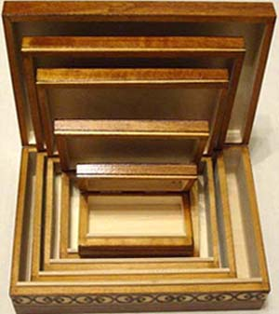
Existing literature on social causes of disease
Social
The social as a precondition for disease
  Susser and Susser (1990) – “Chinese boxes”
  Thisted (2003)
  Direct effect on health and disease
  Cockerham (2007) – social factors can initiate pathology
  Link and Phelan (1995) – social factors as a direct cause of illness
Biological
Kelly et al. (2014)

Slide 7

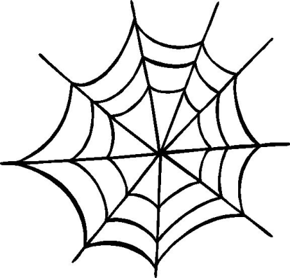

Existing literature on social causes of disease
Population factors
  Rose (2008) – “population strategy”
The “causes of causes”
    Marmot and Wilkinson (2005) – multiple influences across the lifecourse
A “web of causation”
  Krieger (1994) – ecosocial perspective
Kelly et al. (2014)

Slide 8
Research project
Interdisciplinary group: sociologists,
philosophers, medics, psychologists,
historians
Interested in the interface between
the social and biological systems
Identified sociological concepts that
could help negotiate this boundary
Disease causation
Health Inequalities
Developmental programming
Social
Biological
HEALTH

Slide 9
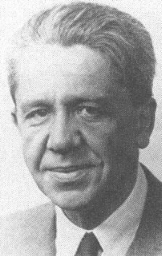
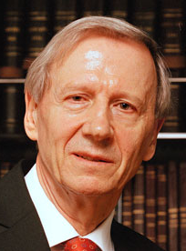
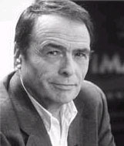
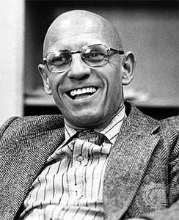
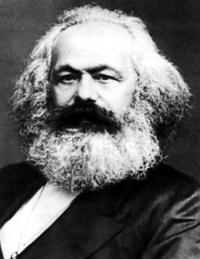
Key sociological concepts
The lifeworld –Schutz
  Sociology and phenomenology
Structuration theory –Giddens
  Sociology and politics
Social practice theories
  Number of theorists: Bourdieu, Giddens, Foucault, Marx…

Slide 10
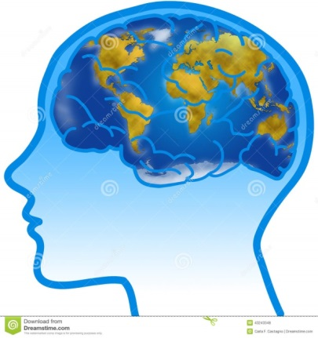
The lifeworld
What is the lifeworld?
How can this contribute to DP?
A way of conceptualising how individuals think about, or model, the world in order to make sense of it
Lived experiences provide us with a view of the world and gives a sense of place and self-worth
Also how individuals understand others’ views of the world – “intersubjectivity”
We all inhabit different lifeworlds and these are shaped by our interactions with others, and their lifeworlds
Interface between biological and the social
Lifeworld of mother and lifeworld of foetus are critical
Uterus as a biological location of social processes

Slide 11
Structuration theory
What is structuration?
How can this contribute to DP?
Structures are consequences of individual actions, but also act on individuals and shape action
Dynamic relationship – you cannot see this if you focus on either structure or agency
There is no “grand plan” for society
Recursive (repetitive) nature
Historical understanding of practices
Exposure to stressors in an interactive way
Action
Structure

Slide 12

Social practice theory
What is social practice theory?
How can this contribute to DP?
Practices are made up of:
  Intersectionality of practices – how certain practices are linked (e.g. healthy breakfast, food shopping, preparing food)
Practices rather than choices are central – avoids individual behavioural focus and blaming individual
Practices shaped by surrounding environment (physical and social)
Recruitment
Cultural expectations and meanings
Adapted from Shove et al (2012)
Requisite knowledge
Materials and resources

Slide 13
Social practice theories
Lifecourse
Structuration
Lifeworld

Slide 14
Thinking about periconceptional diets (and health) using social practice theory
Diet and lifestyles of women of child-bearing age – also partners!
Awareness of lifecourse – experiences which shape lifeworld and expectations
Not just about providing people with information/education and expecting them to make better choices
Need to consider practice-based responses
Moving away from blaming women
Cultural expectations and meanings
Requisite knowledge
Materials and resources

Slide 15
The sociological contribution: social practices
How people view the world, interact with it, the practices they undertake: these are recursive and become routine, habitual – and clearly have a biological impact
All social practices affect health in some way, either positively or negatively
  Not just about individual behaviour or choices – how actions (e.g. healthy breakfast) are influenced by
  wider cultural expectations and meanings,
  being able to obtain the resources to undertake certain actions,
  having the knowledge to participate in practices
  Promoting integrated thinking – practices as a way for social theory to engage more directly with biological processes

Slide 16
References
Cockerham W C (2005) Health Lifestyle Theory and the Convergence of Agency and Structure. Journal of Health and Social Behaviour 46(1): 51-67.
Kelly M P, Kelly R S and Russo F (2014) The Integration of Social, Behavioral, and Biological Mechanisms in Models of Pathogenesis. Perspectives in Biology and Medicine 57(3): 308-328.
Shove E, Pantzar M and Watson M (2012) The dynamics of social practice: everyday life and how it changes. Sage Publications;

Slide 17

Thank you for listening!
Acknowledgements:
St John’s College Annual Fund
Prof. Ann Louise Kinmonth
Prof. Mike Kelly
Contact:
Email: nmk33@cam.ac.uk
Twitter: @NMKriznik

