Slide 1
Social capital, biological capital and health inequalities: Bourdieu meets developmental programming
Dr Natasha Kriznik, St John’s College Cambridge nmk33@cam.ac.uk
Post-Doctoral Research Associate for the St John’s College Reading Group on Health Inequalities
Prof Mike Kelly, Institute of Public Health Cambridge mk744@medschl.cam.ac.uk
BSA Annual Conference, Wednesday 6th April 2016, Aston University

Slide 2
Outline
Developmental programming
The missing sociological contribution
Sociology, biology and health (inequalities)
St John’s Reading Group on Health Inequalities
Bourdieu and capital
Social capital, biological capital and health
Understanding health inequalities through linking social and biological capital
Policy implications

Slide 3
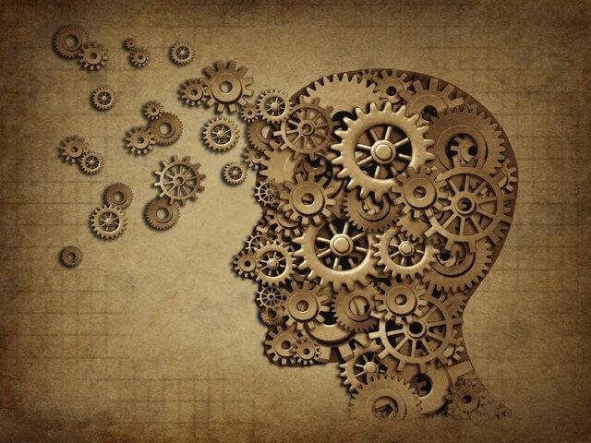
The relationship between the social world and health differences
The association is well-established – first accounts by William Farr in 19th century right through to PHE’s most recent reports on variations in mortality and morbidity
What are the mechanisms?

Slide 4
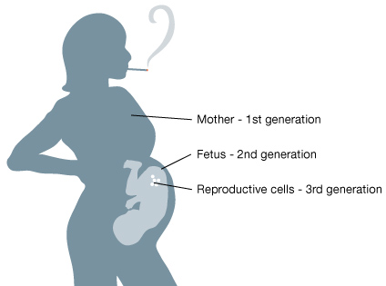
Developmental programming and epigenetics
Growing foetus is sensitive to alterations in the environment
Concern about biological mechanisms – how
physiological adaptations to changes in early
environment lead to permanent programming
of organ systems
How early life events, both in the womb and after birth, influence future (adult) health and well-being – and the transmission of effects across generations

Slide 5
Where’s the sociological contribution?
DP and epigenetics concerned with influence of wider environment and its impact on biological development
Social context is therefore important – e.g. maternal cortisol raised in stressful situations
Sociology has long been aware of the impact of social context on health - but fewer clear attempts to substantially link with biological explanations
  Historical tensions
  Fears of determinism
Yet pregnancy, early years and childhood development are key areas in public health policy and research

Slide 6
Sociology, biology and health (inequalities)
“No longer are social theories thought progressive by virtue of their distance from the biological” (Rose, 2013: 4)
The sociobiological translation: “how human beings receive messages regarding their social conditions, convert the information into perceptions, and then translate the perceptions into biological signals that are antecedents to diseases which may take decades before becoming clinically apparent” (Tarlov, 1996: 71)
Epigenetics “provides a new understanding of the ways in which social and biological experiences and processes intertwine across the life course and may even be inherited across generations” (Warin et al., 2015: 5)

Slide 7
St John’s Reading Group on Health Inequalities
Interdisciplinary group: sociologists,
philosophers, medics, psychologists,
historians
Interested in the interface between
the social and biological systems
Identified sociological concepts that
could help negotiate this boundary
Disease causation
Health Inequalities
Developmental programming
Social
Biological
HEALTH

Slide 8
Bourdieu and “the forms of capital”
Different types of resources people can draw on in their lives
Economic: monetary assets
Cultural: objectified (objects), institutionalised (education), embodied (conduct)
Symbolic: status or recognition

Slide 9
Bourdieu and “the forms of capital”
Different types of resources people can draw on in their lives
Economic: monetary assets
Cultural: objectified (objects), institutionalised (education), embodied (conduct)
Symbolic: status or recognition
“The convertability of the different types of capital is the basis of the strategies aimed at ensuring the reproduction of capital (and the position occupied in social space)” (Bourdieu, 1986: emphasis added)

Slide 10

Social capital and health
Transmission of social (dis)advantage
  Networks as a resource
  Relationships with others –
  “it’s not what you know but who you know”
  Group identity, cohesion
  Collectively owned capital
  Norms, values, practices within the network ⇨ habitus
  “An important task for the emerging field of social epidemiology is to identify the collective characteristics of communities and societies that determine population health status” (Kawachi and Berkman, 2000: 174).

Slide 11
Biological capital and health
Social capital is about transmission of social advantage
We are interested in sociological understanding of the social transmission and social reproduction of biological disadvantage
The clues originally come from David Barker’s foetal origins hypothesis and studies of the effects of the Dutch Famine (Kelly, Kelly, Russo 2014)

Slide 12
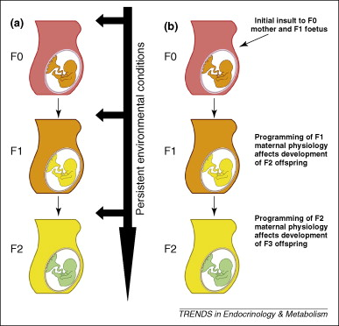
Biological capital and health
Transmission of biological/health (dis)advantage
  Biology/health as a resource given at birth
  Intergenerational transmission (Drake and Liu, 2010)
    Constant environmental exposure (a)
    Maternal effects: physiological, behavioural,
    anatomical (b)
  Dynamic across the lifecourse: can increase or decrease due to environment and behaviours – but always based on initial “stock”
  Individually owned capital

Slide 13
Understanding health inequalities: linking social and biological capital
Structuring effects of social space
Environmental conditions
Impact of relationships
Practices and knowledge
Biological capital
Social capital
Symbolic capital
Amount of social capital depends on other forms of capital
Cultural capital
Economic capital
Time/lifecourse

Slide 14
Policy implications
“Understanding the mechanisms by which programming effects are induced and transmitted across generations has important implications for designing interventions to improve human health.” (Drake and Liu, 2010: 210)
Emphasises the importance of mechanisms linking social and biological systems and transmission of advantage
Moving away from individual and behavioural explanations – the importance of the collective
Stocks of capital change over the life course
Avoid blaming mothers – effect of social space, environment and social practices all embodied through social capital

Slide 15
Conclusion
Developmental programming and epigenetics are important areas for work on health and health inequalities – greater sociological engagement needed
“Biological capital” as a way of theorising our own biological resources and their transmission
Tied in to other forms of capital: social, cultural, symbolic, economic
Integrating social and biological explanations for health inequalities

Slide 16
References
Bourdieu, P (1986) The Forms of Capital. Accessed online: https://www.marxists.org/reference/subject/philosophy/works/fr/bourdieu-forms-capital.htm
Drake A M and Liu L (2010) Intergenerational transmission of programmed effects: public health consequences. Trends in Endocrinology & Metabolism 21(4): 206-213.
Kelly M P, Kelly R S and Russo F (2014) The Integration of Social, Behavioral, and Biological Mechanisms in Models of Pathogenesis. Perspectives in Biology and Medicine 57(3): 308-328.
Rose N (2013) The human sciences in a biological age. Theory, Culture & Society 30(1): 3-34.
Tarlov, A R (1996) Social determinants of health: the sociobiological translation. In D Blane, E Brunner and R Wilkinson (eds) Health and Social Organisation. London: Routledge.
Warin M, Moore V, Davies M and Ulijaszek S (2015) Epigenetics and Obesity: The Reproduction of Habitus through Intracellular and Social Environments. The New Biologies : 1-26.

Slide 17
Thank you
Acknowledgements:
St John’s College Annual Fund
Prof. Mike Kelly (mk744@medschl.cam.ac.uk)
Prof. Ann Louise Kinmonth
Email: nmk33@cam.ac.uk
Twitter: @NMKriznik

