Slide 1
Moving towards relational and dynamic thinking in health inequality policy
.
Mike Kelly, Natasha Kriznik, Ann Louise Kinmonth, Tom Ling
Primary Care Unit
Institute of Public Health
University of Cambridge; and
RAND Cambridge

Slide 2
Policy documents about health inequalities 1976-2010.
Prevention and Health – Everybody’s Business (1976).
The Health of the Nation: A Strategy for Health in England (1992).
Saving Lives: Our Healthier Nation (1999).
Tackling Health Inequalities: A Programme for Action (2003).
Choosing Health: Making Healthy Choices Easier (2004).
Healthy Lives, Healthy People (2010)

Slide 3
By 1999…
Very strong policy commitment especially under New Labour to “tackle” and to reduce health inequalities.

Slide 4
But….
Mackenbach, J.P. (2010) Has the English strategy to reduce health inequalities failed? Social Science and Medicine; 71: 1249-53.

Slide 5
The health gradient
Hi
Health state
Lo
Lo
hi
Social status

Slide 6
The health gradient
Hi
Health state
Lo
Lo
Hi
Social status

Slide 7
Policy documents about health inequalities 1976-2010.
Prevention and Health – Everybody’s Business (1976).
The Health of the Nation: A Strategy for Health in England (1992).
Saving Lives: Our Healthier Nation (1999).
Tackling Health Inequalities: A Programme for Action (2003).
Choosing Health: Making Healthy Choices Easier (2004).
Healthy Lives, Healthy People (2010)

Slide 8
In part it is an absence of a dynamic and relational approach in policy.

Slide 9
A typical argument.
Saving Lives: Our Healthier Nation argued that “the causes of ill-health are many: a complex interaction between personal, social, economic and environmental factors” (Table I, 3B).
Yet the main approach offered to reducing health inequalities focuses on ensuring individuals are informed about risks to their health as “in most cases it is for the individual to decide whether to take the risk” (Table I, 3E).

Slide 10
In sum
Highly individualistic epistemology and associated epistemic assumptions.

Slide 11
In sum
Highly individualistic epistemology and associated epistemic assumptions.
Linear causal thinking.

Slide 12
In sum
Highly individualistic epistemology and associated epistemic assumptions.
Linear causal thinking.
Focus on behaviour and choice.

Slide 13
In sum
Highly individualistic epistemology and associated epistemic assumptions.
Linear causal thinking.
Focus on behaviour and choice.
The nanny state.

Slide 14
In sum
Highly individualistic epistemology and associated epistemic assumptions.
Linear causal thinking.
Focus on behaviour and choice.
The nanny state.
Policy rhetoric pays lip service to the wider determinants.

Slide 15
In sum
Highly individualistic epistemology and associated epistemic assumptions.
Linear causal thinking.
Focus on behaviour and choice.
The nanny state.
Policy rhetoric pays lip service to the wider determinants.
Evidence about the wider determinants used to justify interventions then the focus is on individual behaviour.

Slide 16
In sum
Highly individualistic epistemology and associated epistemic assumptions.
Linear causal thinking.
Focus on behaviour and choice.
The nanny state.
Policy rhetoric pays lip service to the wider determinants.
Evidence about the wider determinants used to justify interventions then the focus is on individual behaviour.

Slide 17
All of this in spite of :
A very large evidence base drawing on sociological, biological, historical, neuroscientific, philosophical and psychological evidence about the dynamic and relational nature of the phenomena.

Slide 18
A brief governmental excursus into complexity.

Slide 19
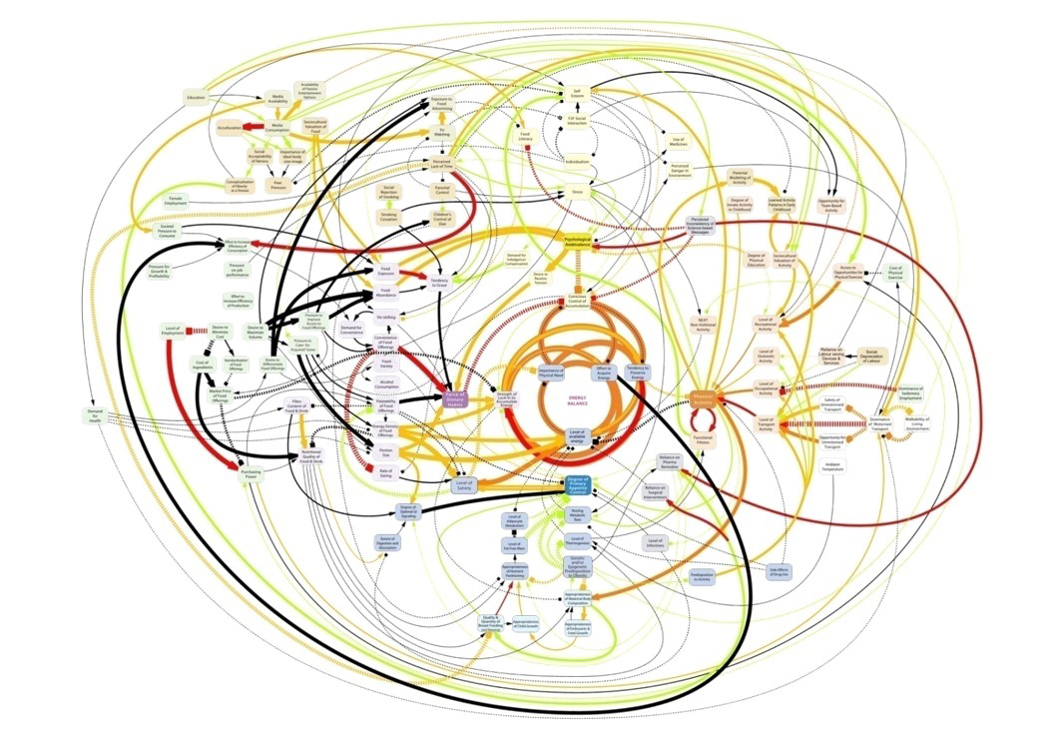
Obesity and the Foresight Report.
Notes:
When it looks something like this….

Slide 20
How the individualistic epistemology works.
Shifts responsibility to individuals and away from industry, advertisers and the state.

Slide 21
How the individualistic epistemology works.
Shifts responsibility to individuals and away from industry, advertisers and the state.
“Its obvious, its about individuals” – the individuated self in the Western psyche and legal systems.

Slide 22
How the individualistic epistemology works.
Shifts responsibility to individuals and away from industry, advertisers and the state.
“Its obvious, its about individuals” – the individuated self in the Western psyche and legal systems.
The individual in the epidemiological method.

Slide 23
How the individualistic epistemology works.
Shifts responsibility to individuals and away from industry, advertisers and the state.
“Its obvious, its about individuals” – the individuated self in the Western psyche and legal systems.
The individual in the epidemiological method.
Measurement of individual characteristics not relational ones.

Slide 24
How the individualistic epistemology works.
Shifts responsibility to individuals and away from industry, advertisers and the state.
“Its obvious, its about individuals” – the individuated self in the Western psyche and legal systems.
The individual in the epidemiological method.
Measurement of individual characteristics not relational ones.
The risk factor approach - smoking, diet, physical inactivity, alcohol consumption.

Slide 25
Measurement of social differentiation.
SES is taken as an aggregation of individual characteristics.

Slide 26
Variables
Individual characteristics
Relational characteristic
Blood pressure
Height
Personality –Introversion – extraversion
Morbidity
Occupation
Sex
Social class
Gender
Social status
Tribe
Caste

Slide 27
The difference between population health and individual health
Why is Mr Smith, who lives in Glasgow, sick?

Slide 28
The difference between population health and individual health
Why is Mr Smith, who lives in Glasgow, sick?
Why is the health of the population of the West of Scotland worse than everywhere else in the UK?

Slide 29
Measurement of social differentiation.
SES is taken as an aggregation of individual characteristics.
The idea of class is absent in its dynamic sense.

Slide 30
Measurement of social differentiation.
SES is taken as an aggregation of individual characteristics.
The idea of class is absent in its dynamic sense.
The intersections between class, gender, ethnicity, geography, sexual orientation, disability ignored.

Slide 31
Theoretical and empirical dimensions of the contours and dimensions of inequality not well described – the axes of differentiation and their intersection completely missing from policy.

Slide 32
Measurement of social differentiation.
SES is taken as an aggregation of individual characteristics.
The idea of class is absent in its dynamic sense.
The intersections between class, gender, ethnicity, geography, sexual orientation, disability ignored.
The social differentiation in the population glossed over.

Slide 33
Moving towards dynamic/ relational thinking.
Must move beyond linear causal models of risk.

Slide 34
Moving towards dynamic/ relational thinking.
Must move beyond linear causal models of risk.
It is helpful to conceptualise health inequalities as an emergent property of the recursive nature of social life.

Slide 35
Moving towards dynamic/ relational thinking.
Must move beyond linear causal models of risk.
It is helpful to conceptualise health inequalities as an emergent property of the recursive nature of social life.
Need to develop integrated multi disciplinary models of patterning of health inequalities.

Slide 36
Dynamic thinking.
The importance of history large and small.

Slide 37
Gairdner’s death rate data (from Farr) per 000
Eastbourne 15
Rothbury 16
Reigate 17
Dorking 18
Surrey 22
London, York, Plymouth, Bradford, Gateshead, Dudley 27
Leicester, Wolverhampton, Stoke, Coventry, Bolton, Sheffield, Newcastle 30
Leeds 31
Glasgow 32
Hull 33
Manchester 33
Liverpool 36
Public Health in Relation to Air and Water , Edinburgh 1862

Slide 38
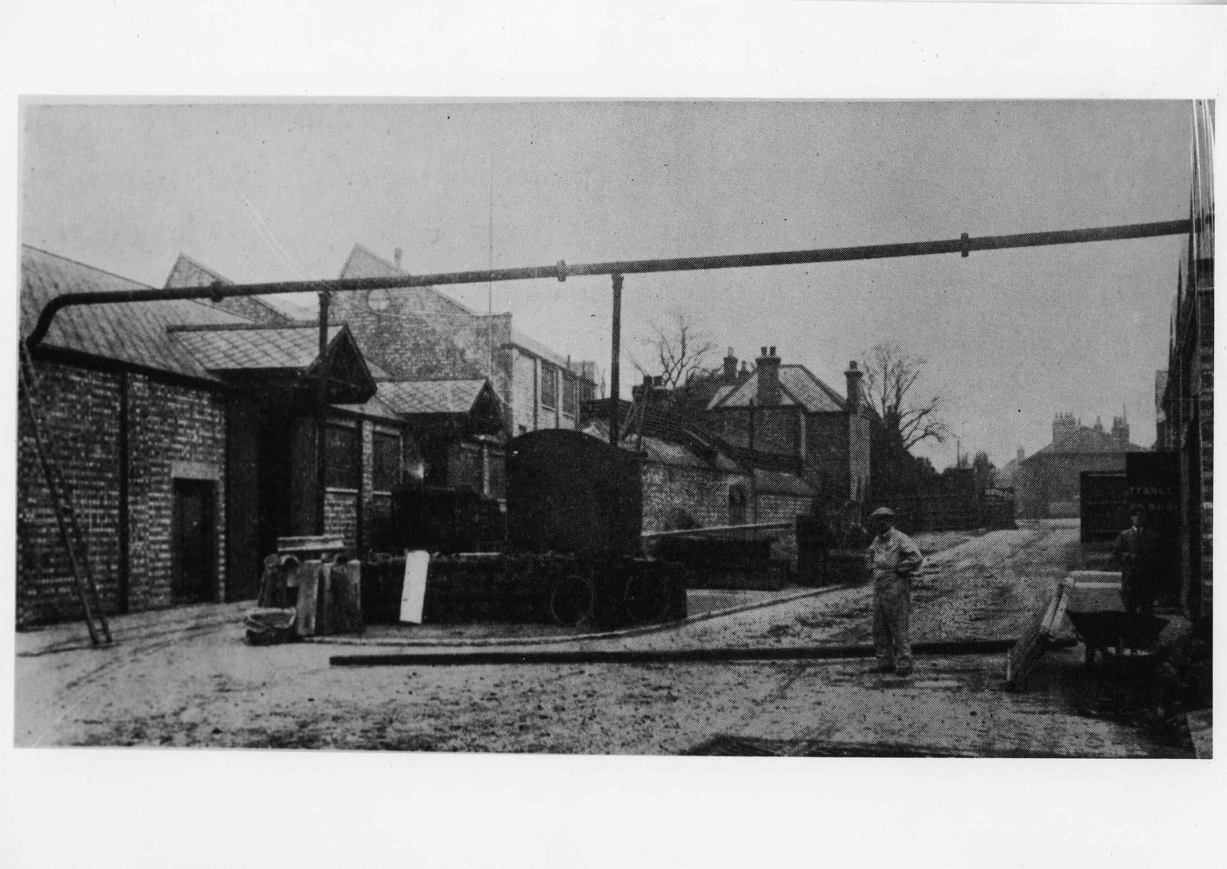

Slide 39
Dynamic thinking.
The importance of history large and small.
The importance of power gender, class and ethnic relations.

Slide 40
Dynamic thinking.
The importance of history large and small.
The importance of power gender, class and ethnic relations.
Biology and in health inequalities – epigenetics and developmental programming.

Slide 41
Developmental programming and epigenetics

Slide 42
Growing foetus is sensitive to alterations in the environment.

Slide 43
Growing foetus is sensitive to alterations in the environment.
How physiological adaptations to changes in early
environment lead to permanent programming
of organ systems.

Slide 44
Growing foetus is sensitive to alterations in the environment.
How physiological adaptations to changes in early
environment lead to permanent programming
of organ systems.
How early life events, both in the womb and after birth, influence future (adult) health and well-being – intergenerational biological and social transmission of disadvantage.

Slide 45
Dynamic thinking.
The importance of history large and small.
The importance of power gender, class and ethnic relations.
Biology and in health inequalities – epigenetics and developmental programming.
Relational ideas of social justice.

Slide 46
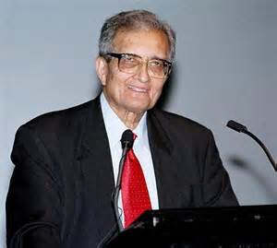

Slide 47
Capabilities
Sen, A. (2009) The Idea of Justice, London: Allen Lane

Slide 48
Dynamic thinking.
The importance of history large and small.
The importance of power gender, class and ethnic relations.
Biology and in health inequalities – epigenetics and developmental programming.
Relational ideas of social justice.
The lessons from economics.

Slide 49
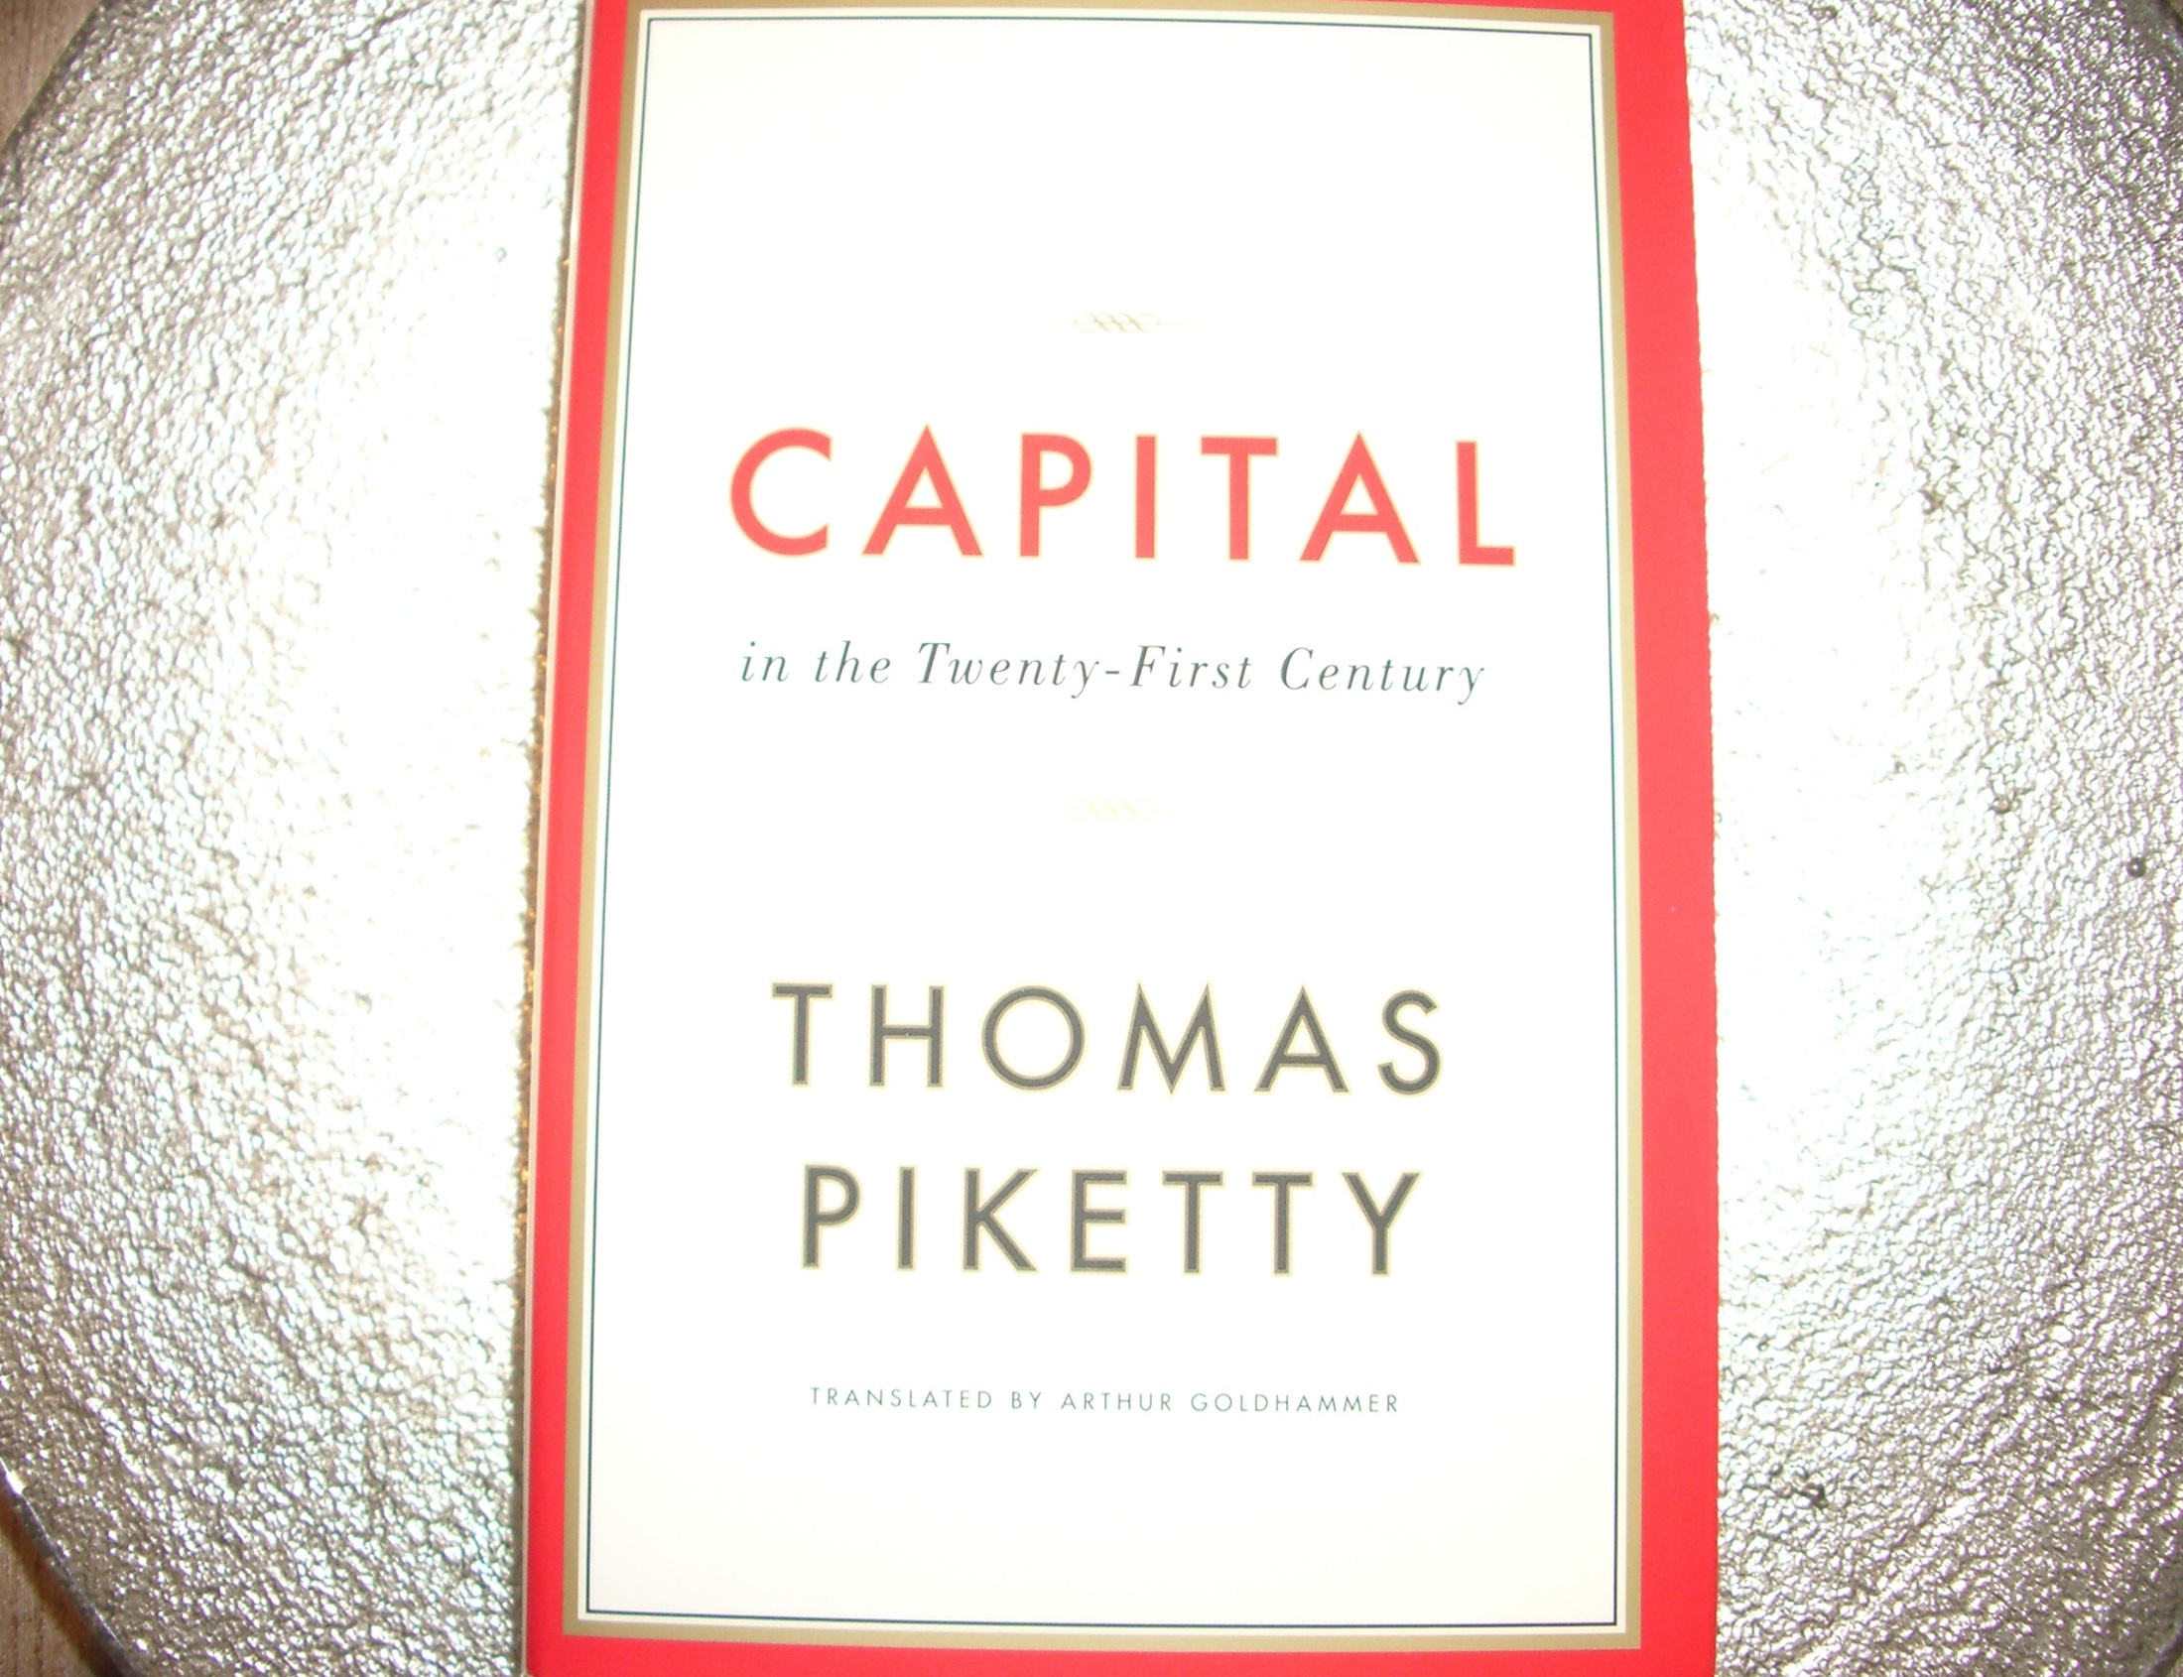

Slide 50
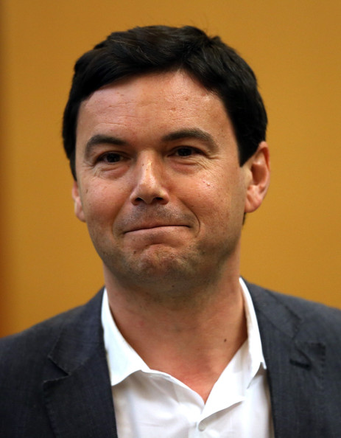

Slide 51
Varoufakis, Y. (2015) The Global Minotaur: America, Europe and the Future of the Global Economy, London: Zed Books.

Slide 52
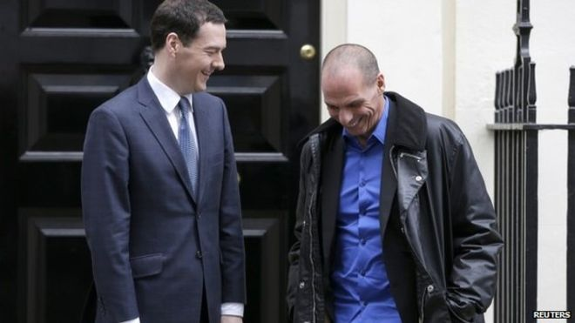

Slide 53
The health gradient
Hi
Health state
Lo
Lo
hi
Social status

Slide 54
Conclusion.
The necessity for a sociological approach.
The need to reframe policy.
The importance of the integrated models and explanations.

Slide 55
Kelly, M.P., Kelly, R., Russo, F. (2014) The integration of social, behavioural and biological mechanisms in models of pathogenesis, Perspectives in Biology and Medicine; 57: 308-28.

Slide 56
Thank you
Acknowledgements:
St John’s College Cambridge Annual Fund and the St John’s College Reading Group on Health Inequalities.
Email: mk744@medschl.cam.ac.uk

